Slide 1
UNIT-II
Dr. Shaik Fathimabi
The Design of HDFS, HDFS Concepts, Blocks, Namenodes and Datanodes, Basic Filesystem Operations, Hadoop Filesystems, Interfaces, The Java Interface, Reading Data from a HadoopURL, Data Flow, Anatomy of a FileRead, Anatomy of a FileWrite, Coherency Model.

Slide 2
The Hadoop Distributed File System
When a dataset outgrows the storage capacity of a single physical machine, it becomes necessary to partition it across a number of separate machines.
File systems that manage the storage across a network of machines are called distributed file systems.
Since they are network-based, all the complications of network programming kick in, thus making distributed file systems more complex than regular disk systems.
One of the biggest challenges is making the file system tolerate node failure without suffering data loss.
Hadoop comes with a distributed file system called HDFS, which stands for Hadoop Distributed File System.

Slide 3
The Design of HDFS
HDFS is a file system designed for storing very large files with streaming data access patterns, running on clusters of commodity hardware.
1. Very large files:
Very large files means files that are hundreds of megabytes, gigabytes, or terabytes in size. There are Hadoop clusters running today that store petabytes of data.

Slide 4
2. Streaming data access
HDFS is built around the idea that the most efficient data processing pattern is a write-once, read-many-times patterns.
A dataset is typically generated or copied from source, then various analyses are performed on that dataset over time.
Each analysis will involve a large proportion, if not all, of the dataset, so the time to read the whole dataset is more important than the latency in reading the first record.
3. Commodity Hardware:
Hadoop doesn’t require expensive, highly reliable hardware to run on.
It’s designed to run on clusters of commodity hardware for which the chance of node failure across the cluster is high, at least for large clusters.
HDFS is designed to carry on working without a noticeable interruption to the user in the face of such failure.

Slide 5
Areas where HDFS is not good fit:
Low-latency data access:
Applications that require low-latency access to data, in the tens of milliseconds range, will not work well with HDFS.
HDFS is optimized for delivering a high throughput of data, and this may be at the expense of latency.
Hbase is currently a better choice for low-latency access.

Slide 6
2. Lots of small files
Since the name-node holds file system metadata in memory, the limit to the number of files in a file system is governed by the amount of memory on the name-node.
As a rule of thumb, each file, directory, and block takes about 150 bytes. Eg:
If u had one million files, each taking one block, u would need at least 300MB of memory.
While storing millions of files is feasible, billions is beyond the capability of current hardware.
3. Multiple writes, arbitrary file modifications:
Files in HDFS may be written to by a single writter. Writes are always made at the end of the file.
There is no support for multiple writers, or for modifications at arbitrary offsets in the file.

Slide 7
HDFS Concepts
Blocks:
A disk has a variable block size, which is the minimum amount of data that it can read or write.
Filesystems for a single disk build on this by dealing with data in blocks, which can be integral multiples of the disk block size.
File systems block are typically a few kilobytes in size, while disk blocks are normally 512 bytes.

Slide 8
There are tools for maintaining performance of file system , such as df and fsck that operate on the file system block level.
Why is block in HDFS so Large(64MB)?
HDFS blocks are large compared to disk blocks, and the reason is to minimize the cost of seeks.
By making a block large enough, the time to transfer the data from the disk can be made to be significantly larger than the time to seek to the start of the block,. Thus the time to transfer a large file made of multiple blocks operates at the disk transfer rate.
A quick calculation shows that if the seek time is around 10ms, & the transfer rate is 100MB/s, then to make the seek time 1% of the transfer time, we need to make the block size around 100MB. The default is 64MB , but many HDFS installations uses 128MB blocks.

Slide 9
Having a block abstraction for a distributed file system brings several benefits.
A File can be larger than any single disk in the network. There’s nothing that requires the blocks from a file to be stored on the same disk, so they can take advantage of any of the disks in the cluster.
Second, making the unit of abstraction a block rather than a file simplifies the storage subsystem.. The storage subsystems deals with blocks, simplifying storage management and eliminating metadata concerns.
Blocks fit well with replication for providing fault tolerance and availability.
% hadoop fsck / -files –blocks -will list the blocks that make up each file in the file system.

Slide 10
Namenodes and Datanodes
HDFS cluster has two types of nodes operating in a master-worker pattern. A namenode (the master) & a number of datanodes (workers).
The namenode manages the filesystem namespace. It maintains the filesystem tree & the metadata for all the files & directories in the tree. This information is stored on the local disk in the form of two files: the namespace image and their edit log.
The namenode also knows the datanodes on which all the blocks for a given file are located.
Datanodes are the workhorses of the filesystem. They store and retrieve blocks when they are told to and they report back to the namenode periodically with lists of blocks that they are storing.
Without the namenode, the filesystem cannot be used. If the machine running the namenode were failed, all the files on the filesystem would be lost since there would be no way of knowing how to reconstruct the files from the blocks on the datanodes.

Slide 11
For this reason, it is important to make the namenode resilient to failure, and Hadoop provides two machanisms for this:
1st way is to back up the files that make up the persistent state of the filesystem metadata.
It is also possible to run a secondary namenode, which despite its name does not act as a namenode. Its main role is to periodically merge the namespace image with the edit log to prevent the edit log from becoming too large. However, the state of secondary namenode lags that of the primary, so in the event of total failure of the primary, data loss is almost certain. In this situation is to copy the namenode’s metadata files that are on NFS to the secondary & run it as primary.

Slide 12
Basic File System Operations
The file-system is ready to be used, & we can do all the usual file-system operations such as reading files, creating directories, moving files, deleting data, an listing directories.
You can type hadoop fs –help to get detailed help on every command.
Copying a file from the local file system to HDFS:
Eg:
% hadoop fs –copyFromLocal input/docs/quangle.txt hdfs://localhost/user/tom/quangle.txt
% hadoop fs –copyFromLocal input/docs/quangle.txt /user/tom/quangle.txt
% hadoop fs –copyFromLocal input/docs/quangle.txt quangle.txt
Copying the file back to the local filesystem and check whether it’s the same:
% hadoop fs –copyToLocal quangle.txt quangle.copy.txt
% md5 input/docs/quangle.txt quangle.copy.txt
% hadoop fs –mkdir books
% hadoop fs –ls

Slide 13
HDFS Federation
The namenode keeps a reference to every file and block in the filesystem in memory, which means that on very large clusters with many files, memory becomes the limiting factor for scaling.
HDFS Federation, introduced in the 0.23 release series, allows a cluster to scale by adding namenodes, each of which manages a portion of the filesystem namespace.
For example, one namenode might manage all the files rooted under /user, say, and a second namenode might handle files under /share. Under federation, each namenode manages a namespace volume, which is made up of the metadata for the namespace, and a block pool containing all the blocks for the files in the namespace.
Namespace volumes are independent of each other, which means namenodes do not communicate with one another, and furthermore the failure of one namenode does not affect the availability of the namespaces managed by other namenodes.
Block pool storage is not partitioned, however, so datanodes register with each namenode in the cluster and store blocks from multiple block pools.

Slide 14
HDFS High-Availability
The combination of replicating namenode metadata on multiple filesystems, and using the secondary namenode to create checkpoints protects against data loss, but does not provide high-availability of the filesystem.
The namenode is still a single point of failure (SPOF), since if it did fail, all clients—including MapReduce jobs—would be unable to read, write, or list files, because the namenode is the sole repository of the metadata and the file-to-block mapping.
In such an event the whole Hadoop system would effectively be out of service until a new namenode could be brought online.

Slide 15
HDFS High-Availability
To recover from a failed namenode in this situation, an administrator starts a new primary namenode with one of the filesystem metadata replicas, and configures datanodes and clients to use this new namenode.
The new namenode is not able to serve requests until it has i) loaded its namespace image into memory, ii) replayed its edit log, and iii) received enough block reports from the datanodes to leave safe mode. On large clusters with many files and blocks, the time it takes for a namenode to start from cold can be 30 minutes or more.

Slide 16
HDFS High-Availability
The 0.23 release series of Hadoop remedies this situation by adding support for HDFS high-availability (HA). In this implementation there is a pair of namenodes in an activestandby configuration.
In the event of the failure of the active namenode, the standby takes over its duties to continue servicing client requests without a significant interruption. A few architectural changes are needed to allow this to happen:
The namenodes must use highly-available shared storage to share the edit log.
When a standby namenode comes up it reads up to the end of the shared edit log to synchronize its state with the active namenode, and Then continues to read new entries as they are written by the active namenode.
Datanodes must send block reports to both namenodes since the block mappings are stored in a namenode’s memory, and not on disk.
Clients must be configured to handle namenode failover, which uses a mechanism that is transparent to users.

Slide 17
File Permissions in HDFS
There are three types of permission:
the read permission (r)
the write permission (w)
the execute permission (x)
The read permission is required to read files or list the contents of a directory.
The write permission is required to write a file, or for a directory, to create or delete files or directories in it.
The execute permission is ignored for a file since you can’t execute a file on HDFS, and for a directory it is required to access its children.
Each file and directory has an owner, a group and a mode. The mode is made up of the permissions for the user who is the owner, the permissions for the users who are members of the group, and the permissions for users who are neither the owners nor members of the group.
By default, a client’s identity is determined by the username and groups of the process it is running in.
When permissions checking is enabled, the owner permissions are checked if the client’s username matched the owner, and the group permissions are checked if the client is a member of the group, otherwise, the other permissions are checked.
There is a concept called super-user, which is the identity of the name-node process. Permission checks are not performed for the super-user.

Slide 18
Hadoop File-Systems
Hadoop has an abstract notation of file-system, of which HDFS is just one implementation.
The java abstract class
org.apache.hadoop.fs.FileSystem
represents a filesystem in Hadoop & there are several concrete implementations:

Slide 19
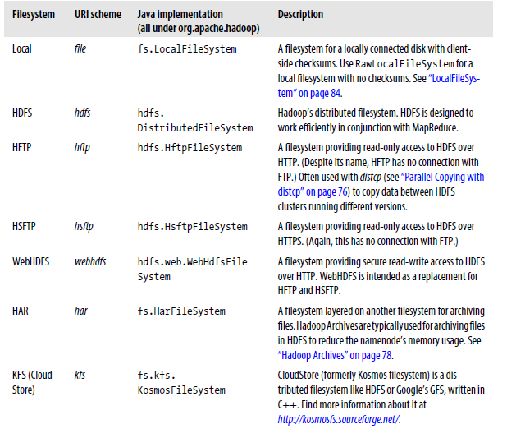

Slide 20
Interfaces
Hadoop is written in Java, & all Hadoop file-system interactions are mediated through the Java API.
The file system shell, is a Java application that uses the Java FileSystem class to provide file system operations.
There are also other file system interfaces
The interfaces are most commonly used with HDFS, since the other file-systems in Hadoop typically have existing tools to access the underlying file-system, but many of them work with any Hadoop file-system.
HTTP
There are two ways of accessing HDFS over HTTP:
Directly:
( where the HDFS daemons( process that runs in the background) serve HTTP requests to clients.
2. Proxy (or Proxies):
which accesses HDFS on the client’s behalf using the usual DistributedFileSystem API.

Slide 21
Client
NameNode
Client
Datanode
Client
Datanode
HTTP Interface Direct :Access
The embedded web servers in the namenode and datanode act as WebHDFS endpoints.

Slide 22
In the first case, directory listings are served by the namenode’s embedded web server(which runs on the port 50070) formatted in XML or JSON, which file data is streamed from datanodes by their web servers (running on port 50075).
The original direct HTTP interface (HFTP and HSFTP) was read-only, while the new WebHDFS implementation supports all file-system operations, including Kerberos authentication. WebHDFS must be enabled by setting dfs.webhdfs.enabled to true, for you to be able to use webhdfs URI’s.

Slide 23
Client
NameNode
HDFS Proxy
RPC Request
Client
Datanode
HDFS Proxy
Block Request
Client
Datanode
Accessing HDFS via a bank of HDFS proxies

Slide 24
The second way accessing HDFS over HTTP relies on one or more standalone proxy servers. All traffic to the cluster passes through the proxy. This allows for stricter firewall and bandwidth limiting policies to be put in place. It’s common to use a proxy for transfers between Hadoop clusters located in different data centers.
The original HDFS proxy was read-only, and could be accessed by clients using the HSFTP FileSystem implementation.
The HTTP REST API that WebHDFS exposes is formally defined in a specification, so it is likely that over time clients in languages other than Java will be written that use it directly.

Slide 25
C Library
Hadoop provides a C library called libhdfs that mirrors the Java FileSystem inteface. It works using the Java Native Interface to call a Java file-system client.
The C API is very similar to the Java one, but it typically lags the Java one, so newer features may not be supported.

Slide 26
FUSE
File-system in Userspace (FUSE) allows file-systems that are implemented in user space to be integrated as a Unix file-system.
Hadoop’s Fuse-DFS contrib module allows any Hadoop file-system to be mounted as a standard file-system. Then you can use Unix utilities to interact with the file-system, as well as POSIX( Portable Operating System Interface for UNIX) libraries to access the file-system from any programming language.

Slide 27
Java Interface
Reading Data from a Hadoop URL
One of the simplest ways to read a file from a Hadoop file-system is by using a java.net.URL object to open a stream to read the data from.
Code
InputStream in = null;
try
{ in=new URL(“hdfs://host/path”).openStream();
// process in
} finally
{
IOUtils.closeStream(in);
}

Slide 28
Example:
Displaying files from a Hadoop file-system on standard output using a URLStreamHandler
Code:
Public class URLCat{
static {
URL.setURLStreamHandlerFactory(new FsUrlStreamHandlerFactory());
}
Public static void main(String[] args) throws Exception{
InputStream in= null;
try {
in=new URL(args[0].openStream();
IOUtils.copyBytes(in, System.out, 4096, false);
}
finally {
IOUtils.closeStream(in); }}}

Slide 29
Execution
Export HADOOP_CLASSPATH=hadoop-examples.jar
Hadoop URLCat hdfs://localhost/user/file.txt
This is the input file contents
Displayed on the screen

Slide 30
Reading Data using the FileSystem API
Example 3-2. Displaying files from a Hadoop filesystem on standard output by using the FileSystem
directly
public class FileSystemCat {
public static void main(String[] args) throws Exception {
String uri = args[0];
Configuration conf = new Configuration();
FileSystem fs = FileSystem.get(URI.create(uri), conf);
InputStream in = null;
try {
in = fs.open(new Path(uri));
IOUtils.copyBytes(in, System.out, 4096, false);
} finally {
IOUtils.closeStream(in); }
}
}

Slide 31
Execution
The open() method on FileSystem actually returns on FSDataInputStream rather than a standard java.io class
This class is a specialization of java.io.DataInputStream with support for random access using seek().
$hadoop FileSystemCat hdfs://localhost/user/file.txt
This is the contents of the file displayed on the screen

Slide 32
Write operation
public class FileCopyWithProgress {
public static void main(String[] args) throws Exception {
String localSrc = args[0];
String dst = args[1];
InputStream in = new BufferedInputStream(new FileInputStream(localSrc));
Configuration conf = new Configuration();
FileSystem fs = FileSystem.get(URI.create(dst), conf);
OutputStream out = fs.create(new Path(dst), new Progressable() {
public void progress() {
System.out.print(".");
}
}
);
IOUtils.copyBytes(in, out, 4096, true);
}
}

Slide 33
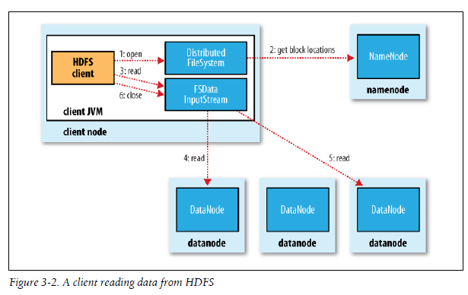
Data Flow
Anatomy of a File Read
To get an idea of how data flows between the client interacting with HDFS, the name-node and the data-nodes.

Slide 34
The client opens the file it wishes to read by calling open() on the FileSystem object, which for HDFS is an instance of DistributedFileSystem
DistributedFileSystem calls the namenode, using RPC(remote procedure call), to determine the locations of the blocks for the first few blocks in the file.
For each block, the namenode returns the addresses of the datanodes that have a copy of that block. The datanodes are stored according to their proximity to the client.
If the client is itself a datanode, then it will read from the local datanode, if it hosts a copy of the block.
The DistributedFileSystem returns an FSDataInputStream to the client for it to read data from. FSDataInputStream in turn wraps a DFSInputStream, which manages the datanode and namenode I/O.
The Client then calls read() on the stream. DFSInputStream, which has stored the datanode addresses for the first few blocks in the file, then connects to the first closet datanode for the first block in the file. Data is streamed from the datanode back to the client, which calls read() repeatedly on the stream.
When the end of the block is reached, DFSInputStream will close the connection to the datanode, then find the best datanode for the next block.
Blocks are read in order with the DFSInputStream opening new connections to datanodes as the client reads through the stream. It will also call the namenode to retrieve the datanode locations for the next batch of blocks as needed. When the client has finished reading, it calls close() on the FSDataInputStream.

Slide 35
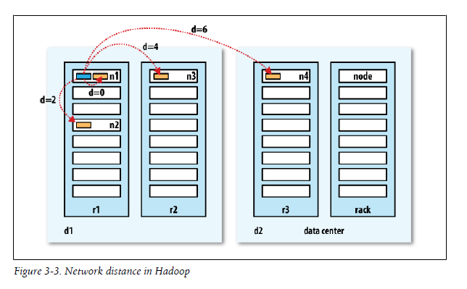
Distance =0 processes on the same node
Distance = 2 different nodes on the same rank
Distance = 4 nodes on different racks in the same data center
Distance = 6 nodes on different data centers

Slide 36
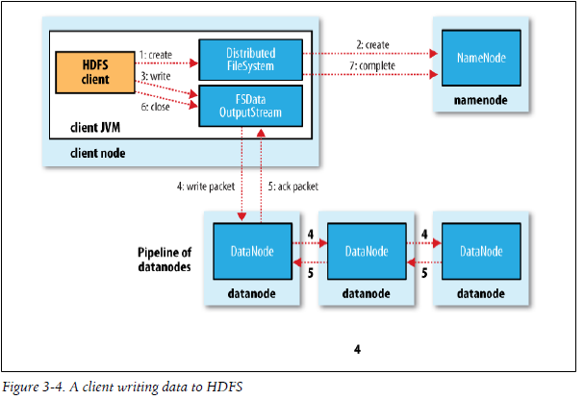
2. Anatomy of a File Write
Creating a new file, writing data to it, then closing the file.

Slide 37
The client creates the file by calling create() on DistributedFileSystem. DistributedFileSystem makes an RPC call to the namenode to create a new file in the filesystem’s namespace, with no blocks associated with it.
The namenode performs various checks to make sure the file doesn’t already exist, and that the client has the right permissions to create the file.
If these checks pass, the namenode makes a record of the new file, otherwise file creation fails and the client is thrown an IOException.
The DistributedFileSystem returns an FSDataOutputStream for the client to start writing data to.
As the client writes data, DFSOutputStream splits it into packets, which it writes to an internal queue, called the data queue. The data queue is consumed by the dataStreamer, whose responsibility it is to ask the namenode to allocate new blocks by picking a list of suitable datanodes to store the replicas.
The list of datanodes forms a pipeline we will assume the replication level is three, so there are three nodes in the pipeline.
The DataStreamer streams the packets to the first datanode in the pipeline, which stores the packet and forwards it to the second datanode in the pipeline. Similarly the second datanode stores the packet and forwards it to the third datanode in the pipeline.
DFSOutputStream also maintains an internal queue of packets that are waiting to be ack by datanodes, called the ack queue. A packet is removed from the ack queue only when it has been ack by all the datanodes in the pipeline.
If a datanode fails while data is being written to it, then the following actions are take, which are transparent to the client writing the data. First the pipeline is closed, and any

Slide 38
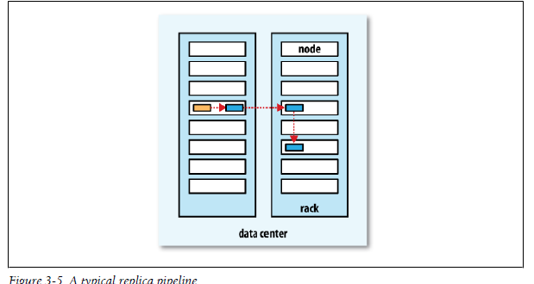

Slide 39
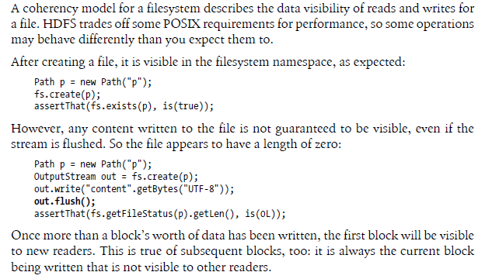
Coherency Model

Slide 40
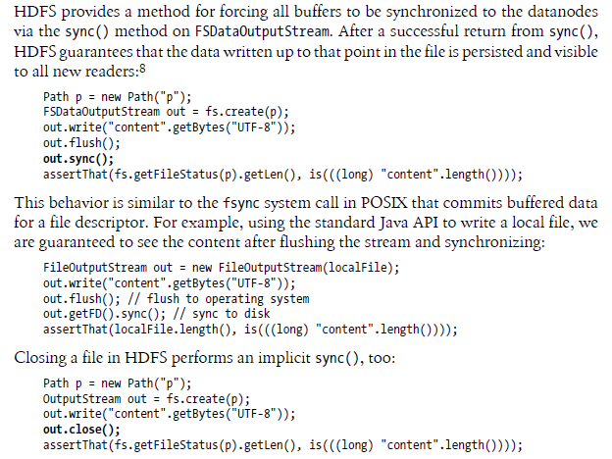

Slide 41
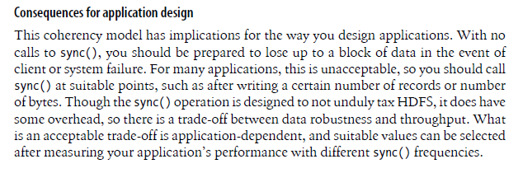

Slide 42
Out.hflush It does not guarangee that the datanodes have written the data to disk, only that its in the datanode memory.
Hsync() is similar to that of the fsync() system call in POSIX that commits buffered data for a file descriptor.

